Slide 1


Department of Computer Science and Engineering
DIABETES PREDICTION
Dr.M.RAKESHKUMAR
Associate Professor
K.S.JAYASURIYAA 220701332
F.KATHIRAVAN 220701505

Slide 2
Problem Statement and Motivation
Diabetes is a growing global health concern, affecting millions of people worldwide. Early detection of the disease can significantly improve the chances of managing the condition and preventing complications. However, traditional diagnostic tools often require extensive medical resources. This project aims to create an accessible and efficient tool that can predict the likelihood of diabetes based on simple medical inputs, allowing users to get early insights into their health

Slide 3
Existing System
Currently, diabetes diagnosis relies heavily on medical tests such as blood glucose levels, A1C tests, and oral glucose tolerance tests. These tests are often expensive, time-consuming, and may not be accessible in all regions. While there are a few existing machine learning-based systems that provide predictions, they often lack user-friendly interfaces, real-time predictions, or accessibility for a broader audience

Slide 4
Objectives
The main objective of this project is to create a user-friendly web application that leverages machine learning (Random Forest model) to predict the likelihood of diabetes in individuals based on medical data.
Build a Predictive Model.
Develop a User-Friendly Web Interface.
Ensure Model Accuracy and Evaluation.

Slide 5
Abstract
This project aims to develop a machine learning-based web application that predicts the likelihood of diabetes in individuals based on key health indicators.
The system uses a Random Forest classification model trained on the Pima Indians Diabetes dataset and is deployed using Streamlit for a simple and interactive web interface.
Users can input medical data such as glucose level, BMI, age, etc., and receive an instant prediction on whether they are likely to have diabetes.
This solution provides an accessible, low-cost, and real-time tool to help individuals .

Slide 6
Proposed System
The proposed system is a web-based application that predicts the risk of diabetes using a machine learning model. Unlike traditional methods, it is fast, cost-effective, and easy to use by anyone without medical expertise
Data Collection
Data Preprocessing
Model Training
Web Interface
Prediction Output

Slide 7
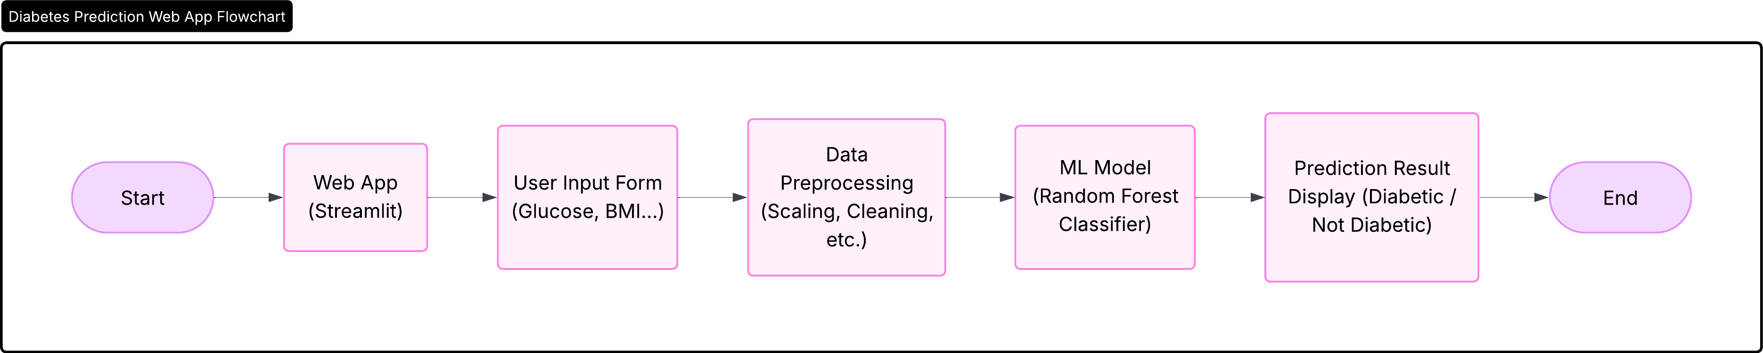
System Architecture

Slide 8
List of Modules
1. User Interface Module
2. Data Preprocessing Module
3. Machine Learning Model Module
4. Prediction Output Module
5. Backend Integration Module

Slide 9
Functional Description for each modules with DFD and Activity Diagram
1. User Interface Module
Function: Takes health input from the user through Streamlit.
2. Data Preprocessing Module
Function: Formats and normalizes input data for the model.
3. Machine Learning Model Module
Function: Loads trained Random Forest model and predicts.
4.Prediction Output Module
Function: Receives result and displays it to the user.
5. Backend Integration Module
Function: Controls the flow from UI → preprocessing → model

Slide 10
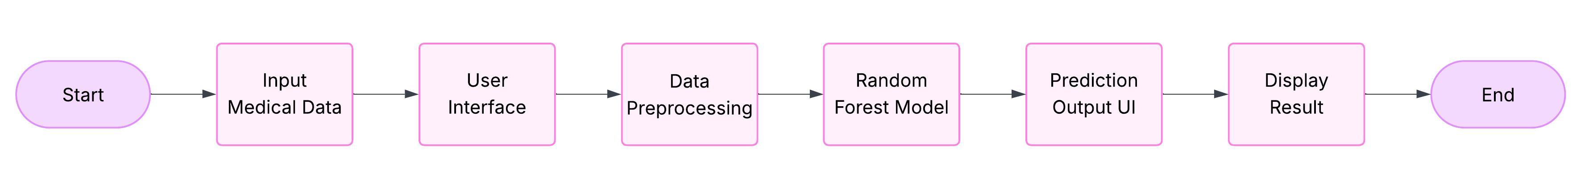
Data Flow Diagram

Slide 11
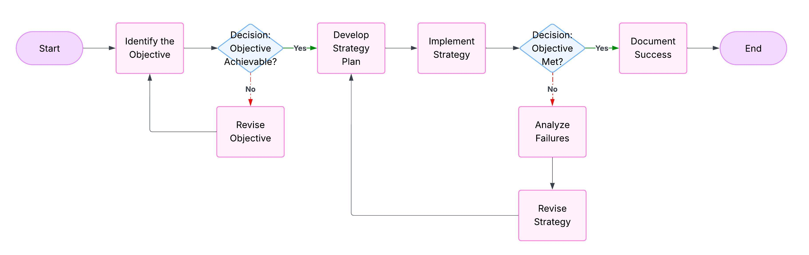
Activity Diagram

Slide 12
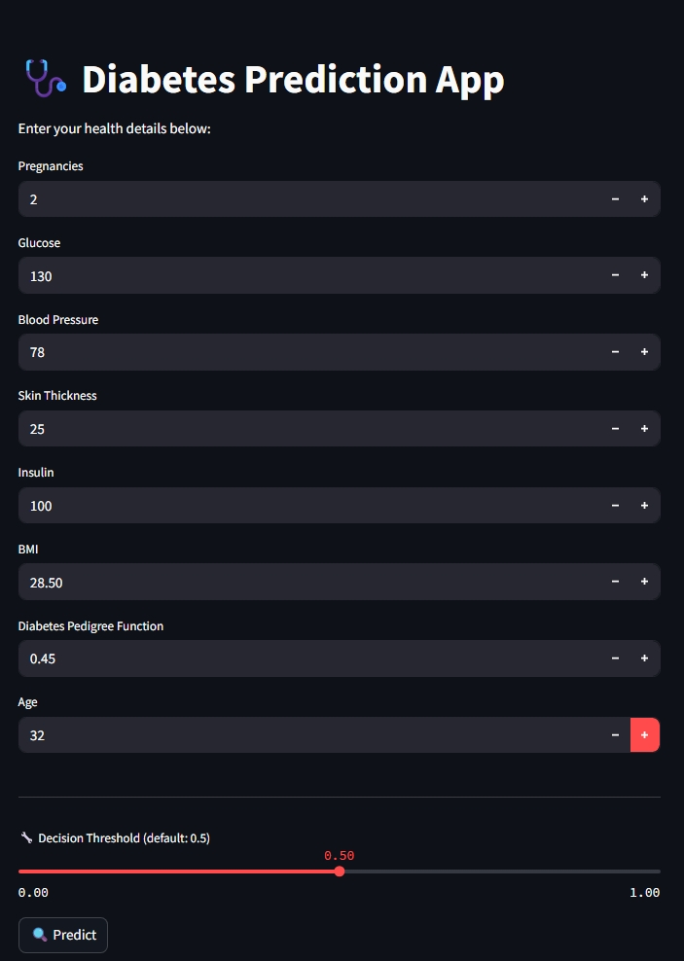
Implementation & Results of Module

Slide 13
Conclusion
The proposed system provides an efficient and accessible solution for early prediction of diabetes using machine learning.
With a user-friendly web interface and a trained Random Forest model, it delivers quick and reliable results based on user health parameters.
The model achieved promising accuracy (around 82%), making it suitable for real-world use as a screening tool.

Slide 14
Future Work
1. Dataset Expansion: Include larger and more diverse datasets to improve accuracy and reduce bias.
2. Model Improvement: Explore deep learning models (e.g., Neural Networks) for better performance.
3. Real-time Data Integration: Connect to wearable devices or mobile health apps for live monitoring and prediction.
4. User Account & History: Allow users to register/login and view past prediction history.

Slide 15
References
[1] Chicco, D., & Jurman, G. (2021). The coefficient of determination R-squared is more informative than SMAPE, MAE, MAPE, MSE and RMSE in regression analysis evaluation. PeerJ Computer Science, 7, e623. This study emphasizes the importance of the R² score in evaluating regression models, suggesting it provides more informative insights compared to other metrics like MAE and MSE.
[2] Hanane Dupouy. (2023). Evaluation Metrics For Regression Models. This article provides a comprehensive overview of various evaluation metrics for regression models, including R², MSE, RMSE, MAE, MAPE, and MedAE, offering practical examples using Python.
[3] Aman Kharwal. (2023). Regression Performance Evaluation Metrics. This resource discusses the significance of MAE, MSE, RMSE, and R² in assessing the performance of regression models, providing insights into their interpretation and application.
[4] Madhuri Patil. (2021). Performance Metrics for Regression Algorithms. This article delves into the various performance metrics used to evaluate regression algorithms, highlighting their importance in model assessment.
[5] Chicco, D., & Jurman, G. (2020). The Advantages of the Matthews Correlation Coefficient (MCC) Over F1 Score and Accuracy in Binary Classification Evaluation. BMC Genomics, 21, 6.

Slide 16
Thank You

